Slide 1
Crystal Mono Design
Tolerance Analysis

Slide 2
i. Parameters
eV | Hkl | Miscut | N
17795 | 660 | 27.98 | 2048
15275 | 660 | 34.35 | 2048
12665 | 440 | 25.65 | 2048
9481 | 440 | 27.98 | 2048

Slide 3
1. f1 optimization
Simulating pulse duration as a function of f1.
incident pulse duration: 400 fs
sampling time window: 20000 fs
slit width at focus: 2000 um

Slide 4
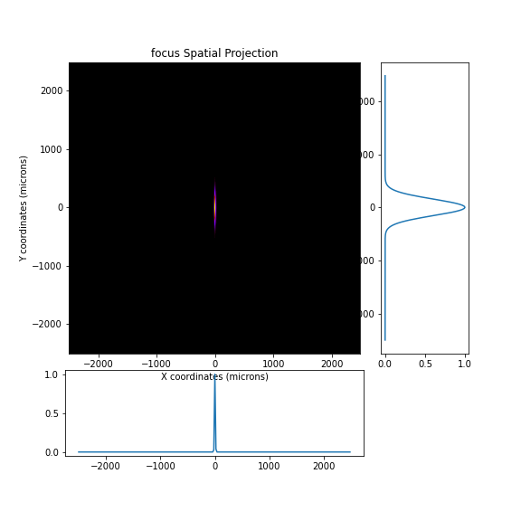
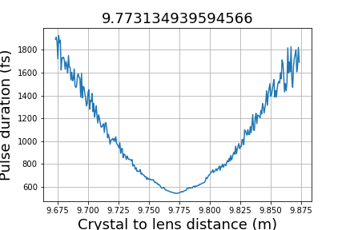
1). 17795 eV

Slide 5
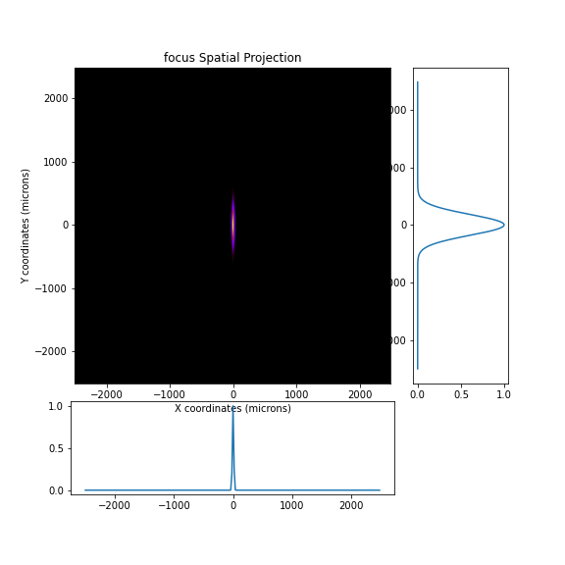
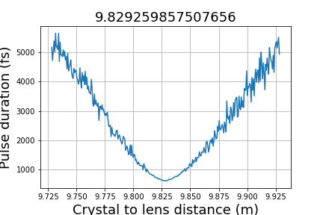
2). 15275 eV

Slide 6
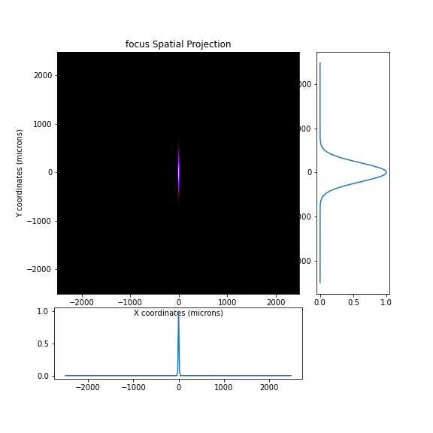
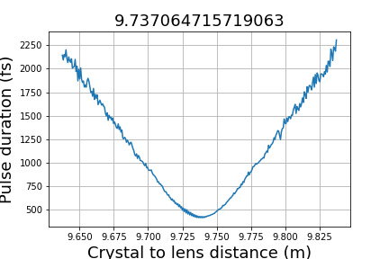
3). 12665 eV

Slide 7

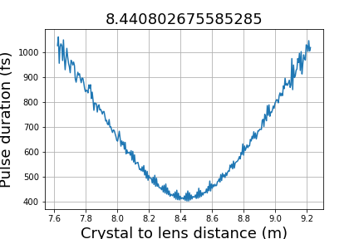
4). 9481 eV

Slide 8
2. Crystal pitch angle tolerance
incident pulse duration: 100 fs
sampling time window: 4000 fs
slit width at focus: 100 um (pulse duration, pulse-front tilt)
7 um (bandwidth, throughput, central energy)

Slide 9
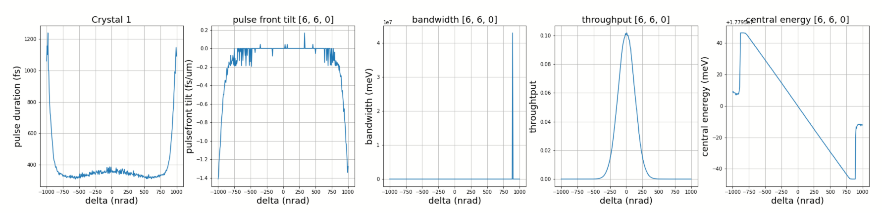
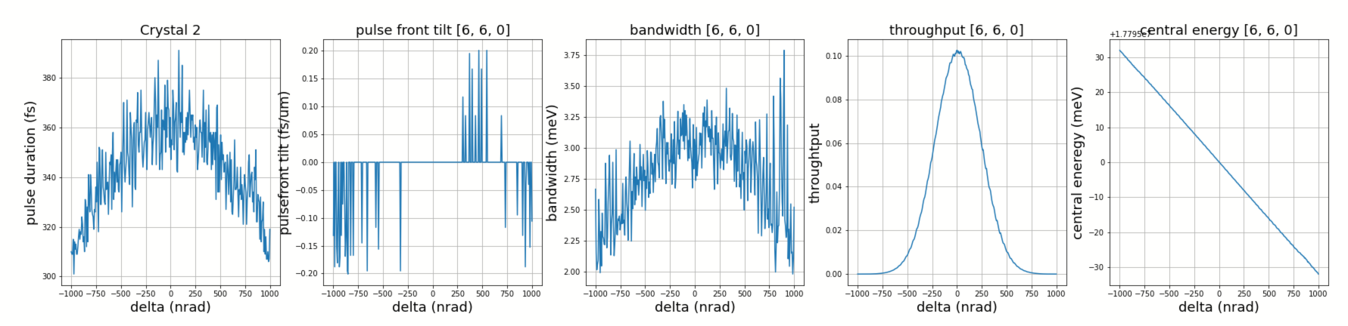
1). 17795 eV

Slide 10
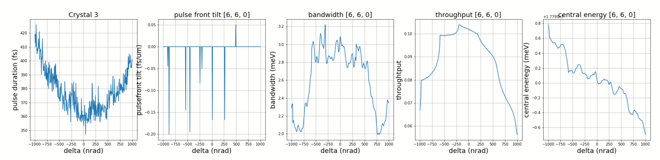
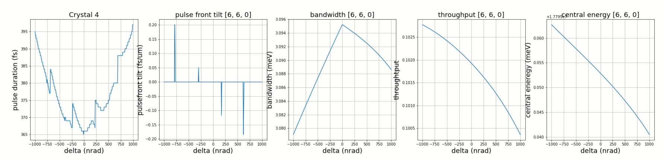
1). 17795 eV

Slide 11
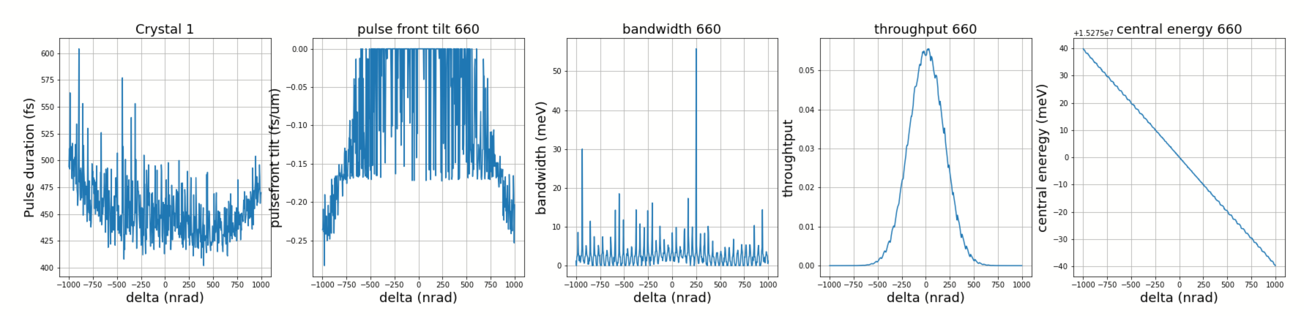
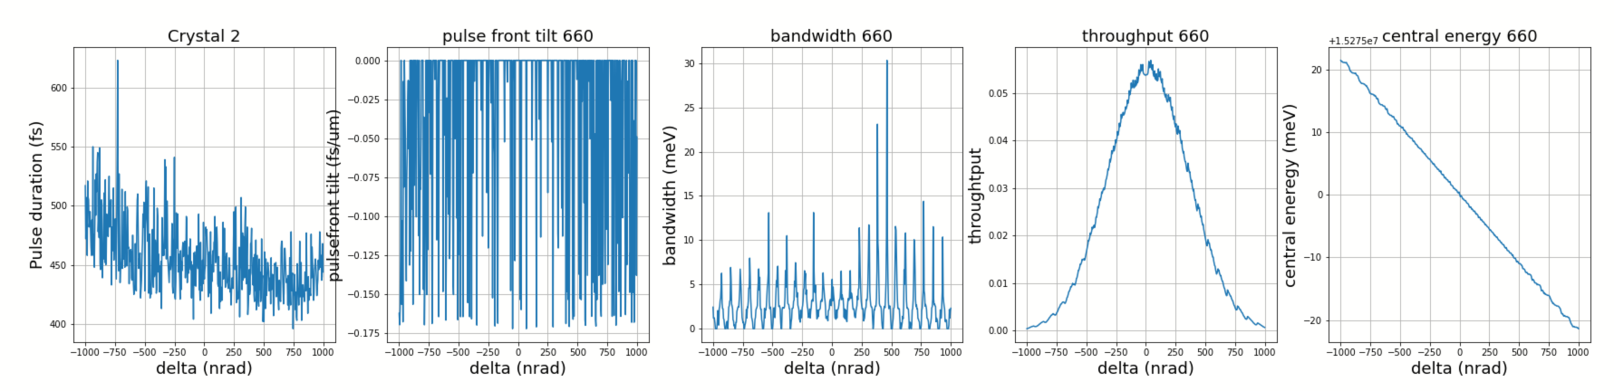
2). 15275 eV

Slide 12
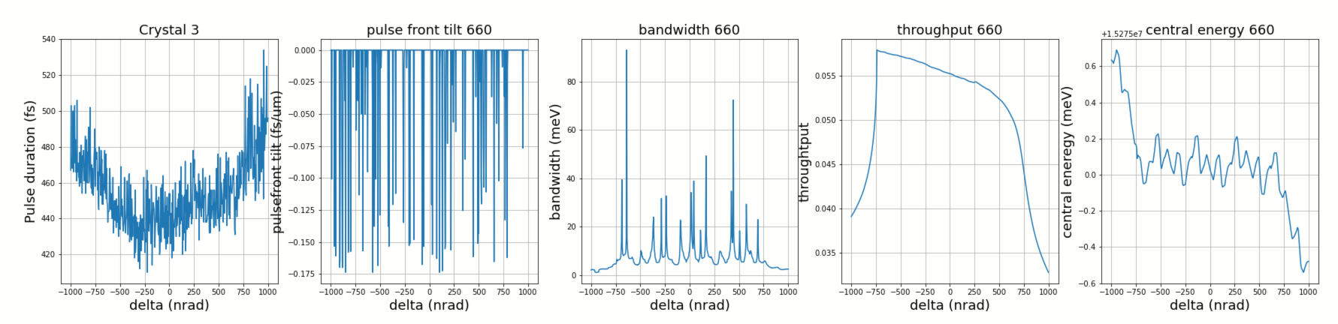
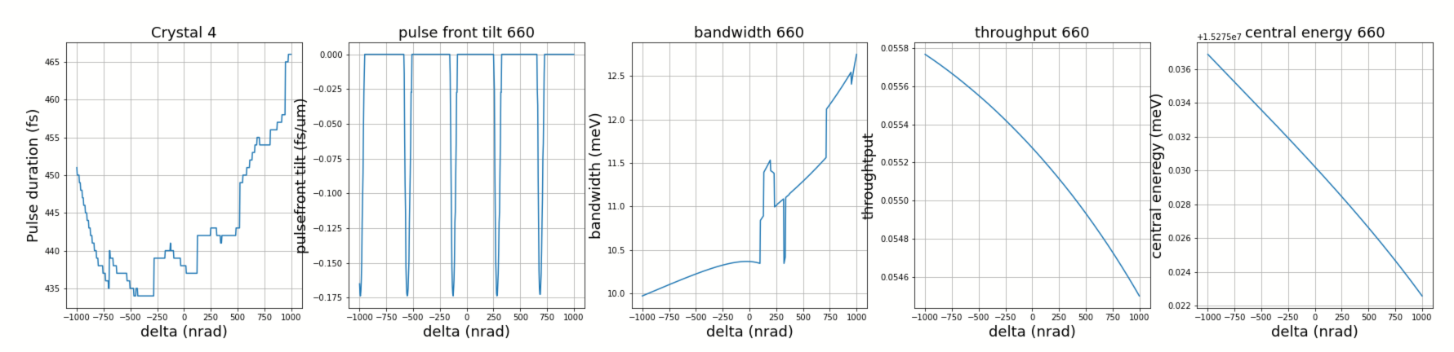
2). 15275 eV

Slide 13
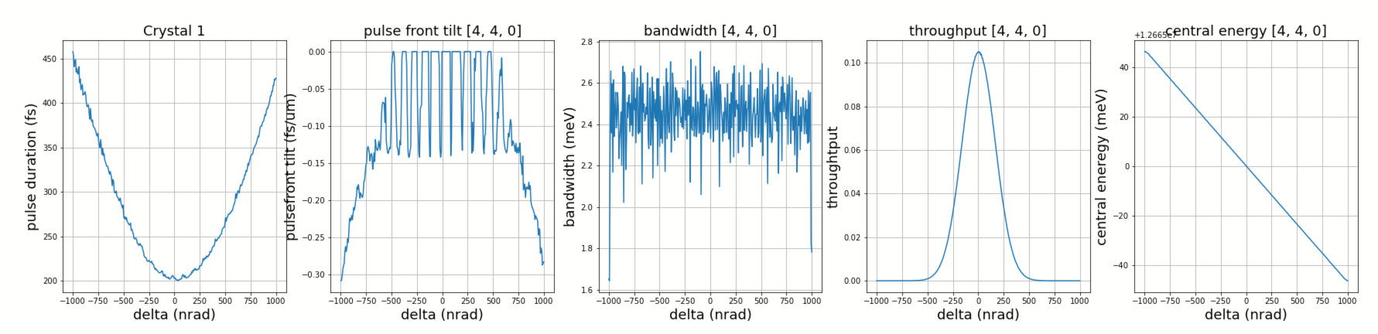
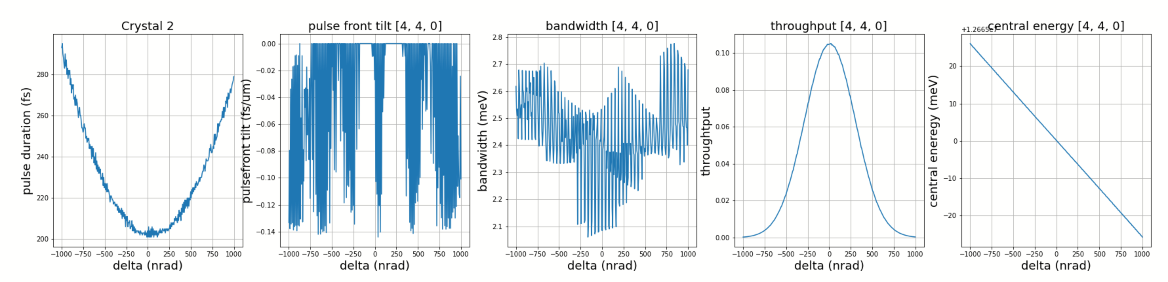
3). 12665 eV

Slide 14
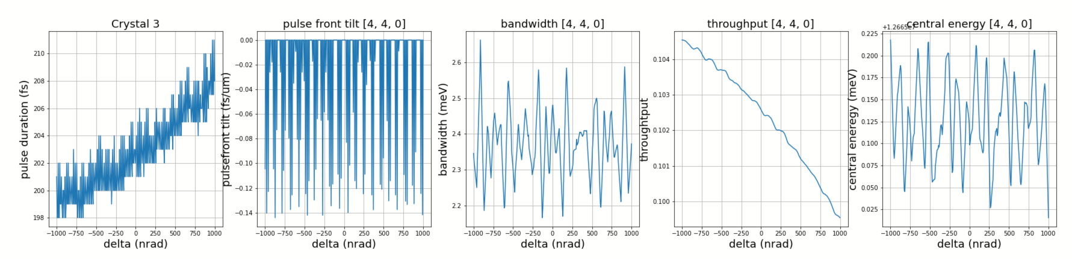
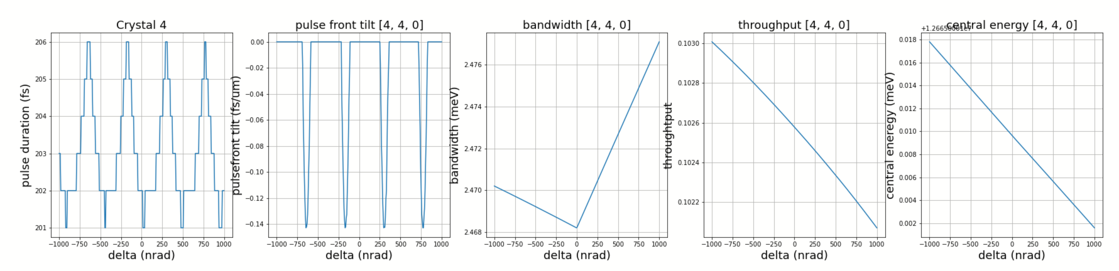
3). 12665 eV

Slide 15
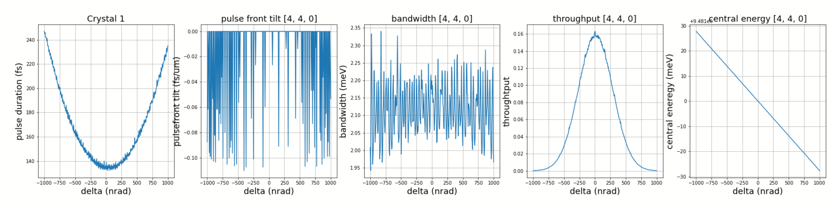
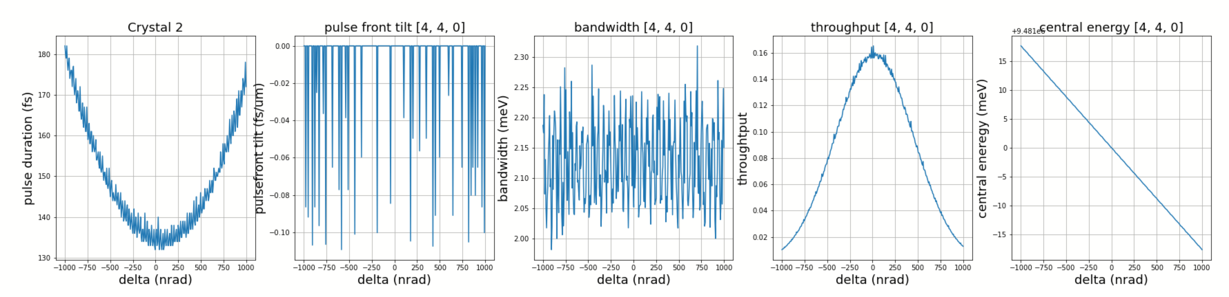
4). 9481 eV

Slide 16
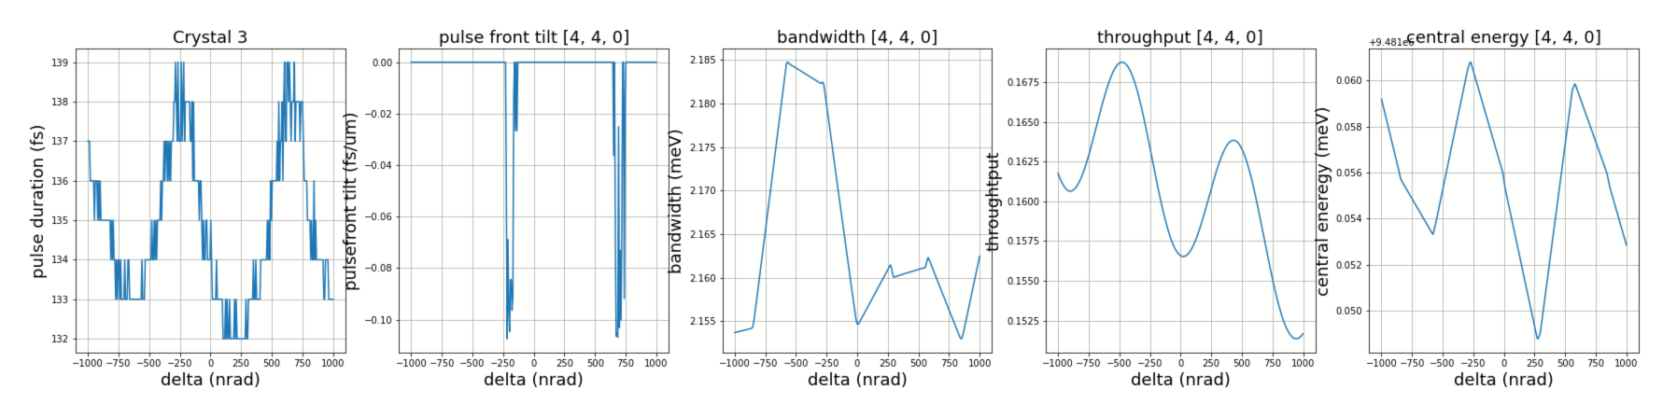
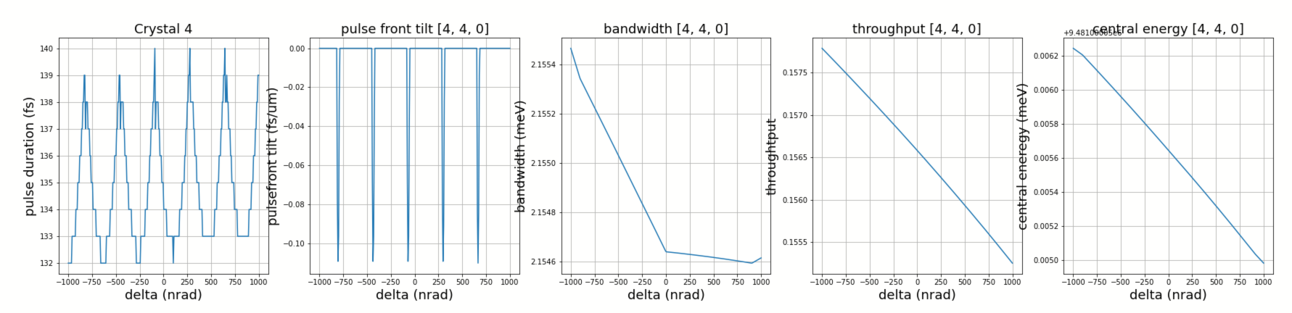
4). 9481 eV

Slide 17
3. Longitudinal shift tolerance
incident pulse duration: 100 fs
sampling time window: 4000 fs
slit width at focus: 100 um (pulse duration, pulse-front tilt)
7 um (bandwidth, throughput, central energy)

Slide 18
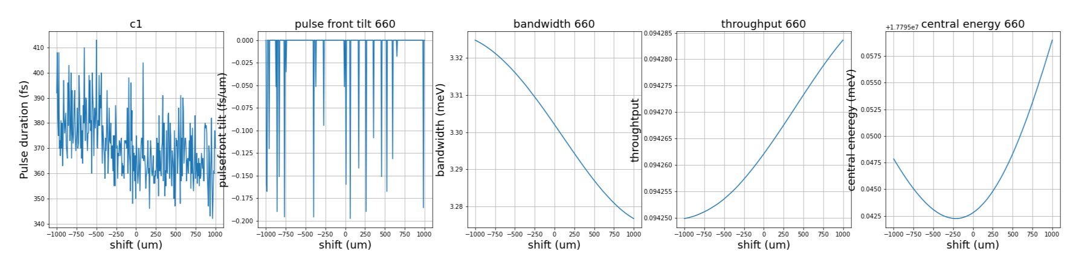
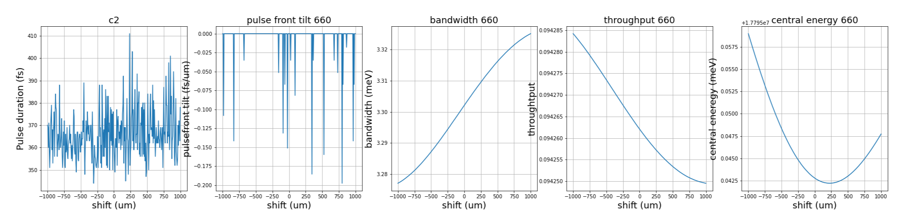
1). 17795 eV

Slide 19
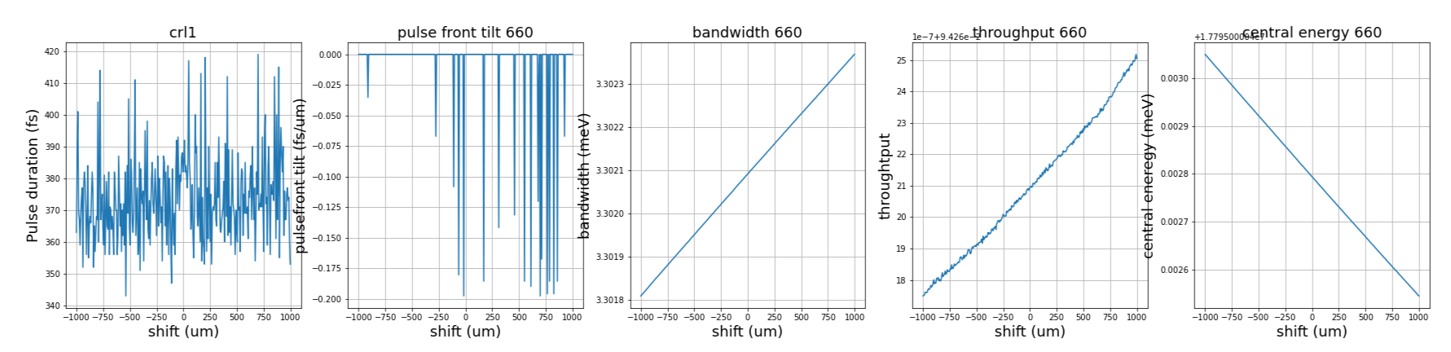
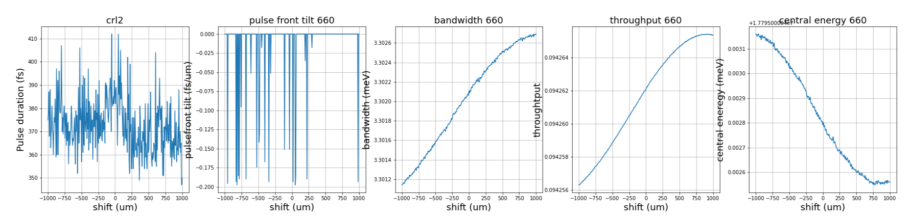
1). 17795 eV

Slide 20
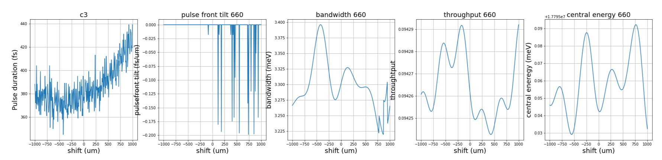
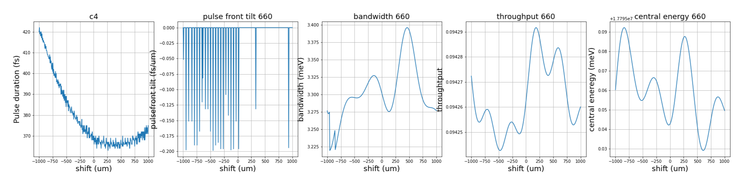
1). 17795 eV

Slide 21
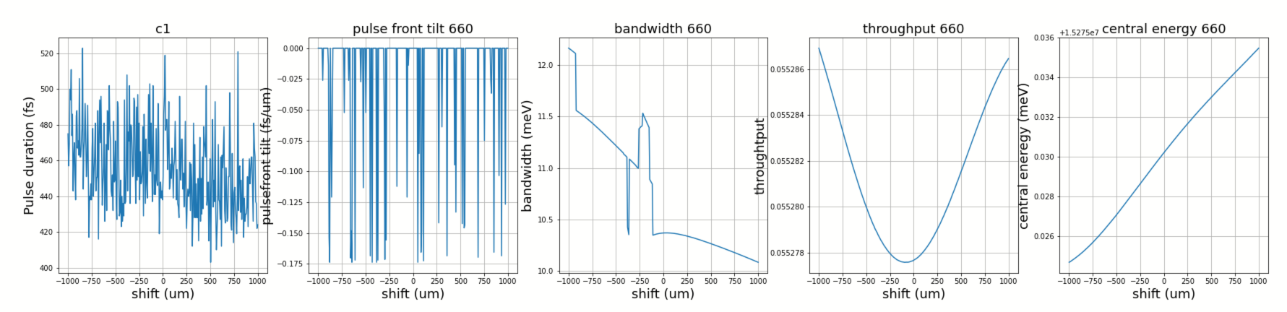
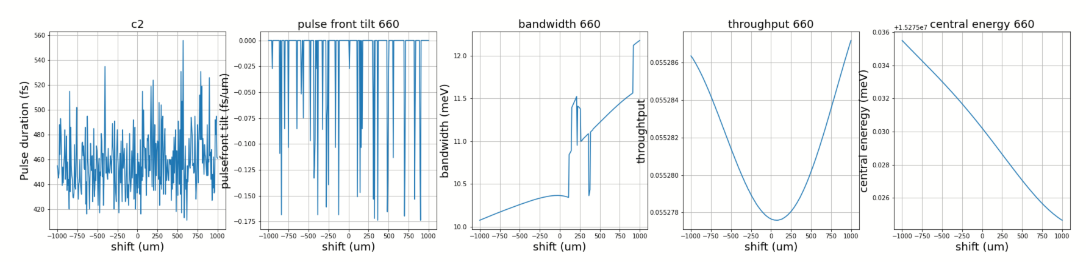
2). 15275 eV

Slide 22
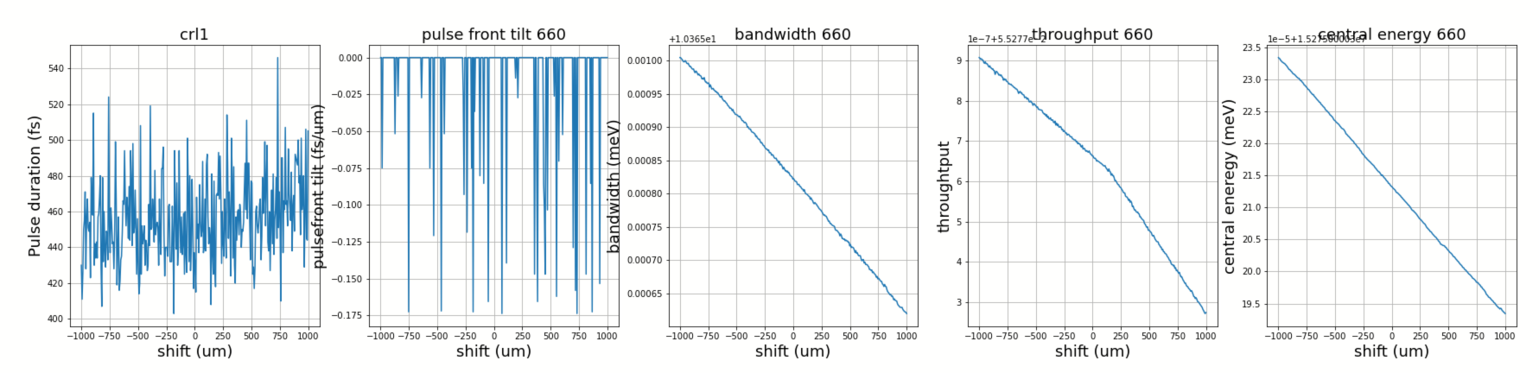
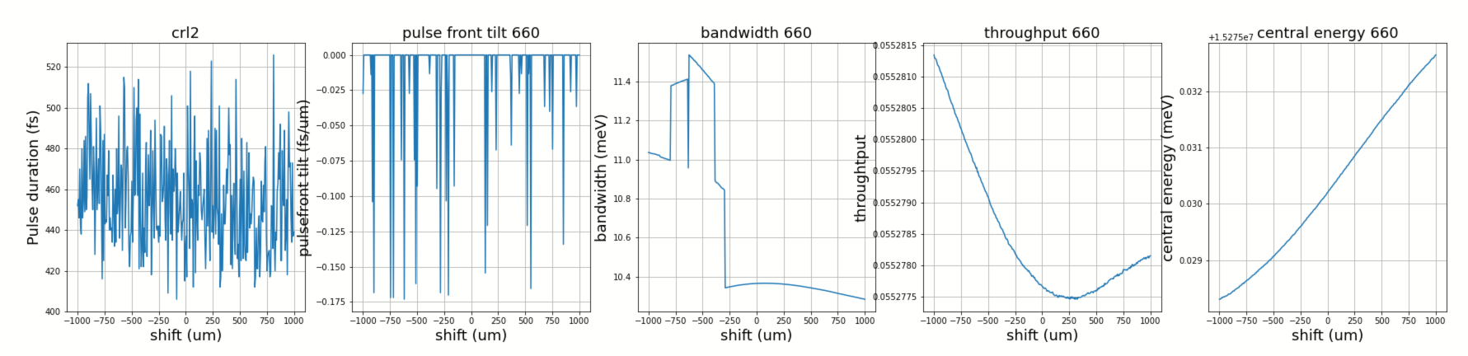
2). 15275 eV

Slide 23
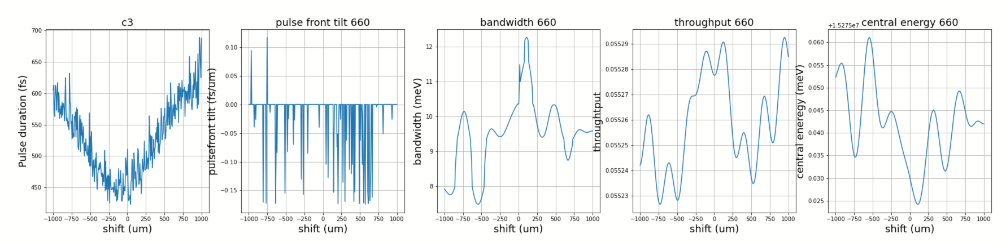
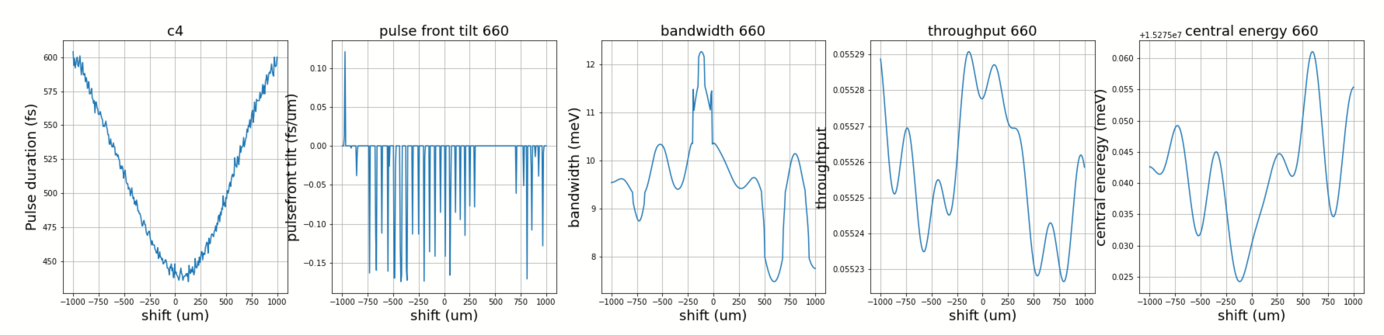
2). 15275 eV

Slide 24
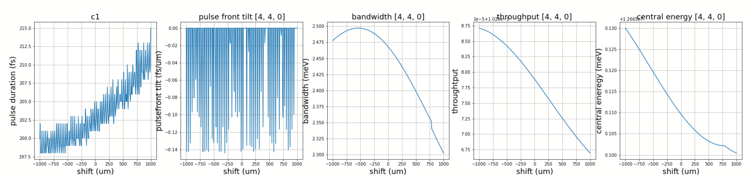
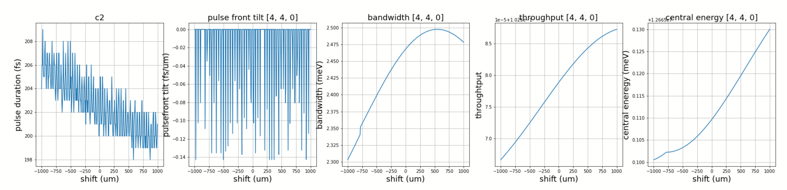
3). 12665 eV

Slide 25
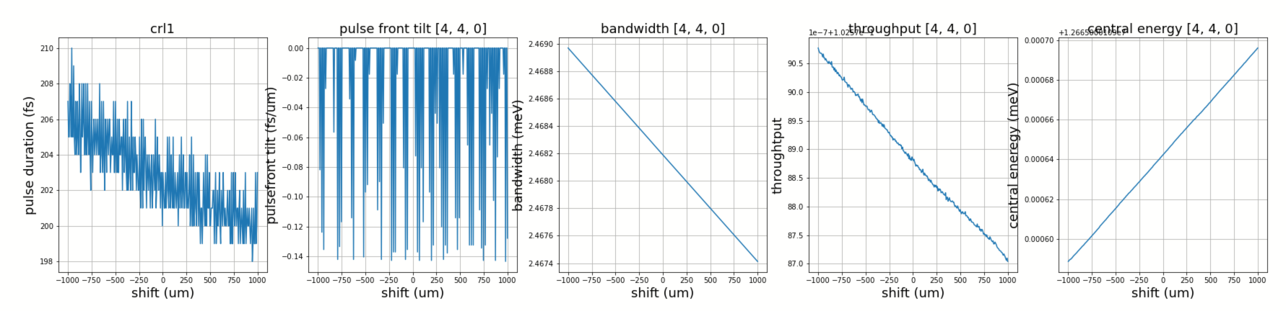
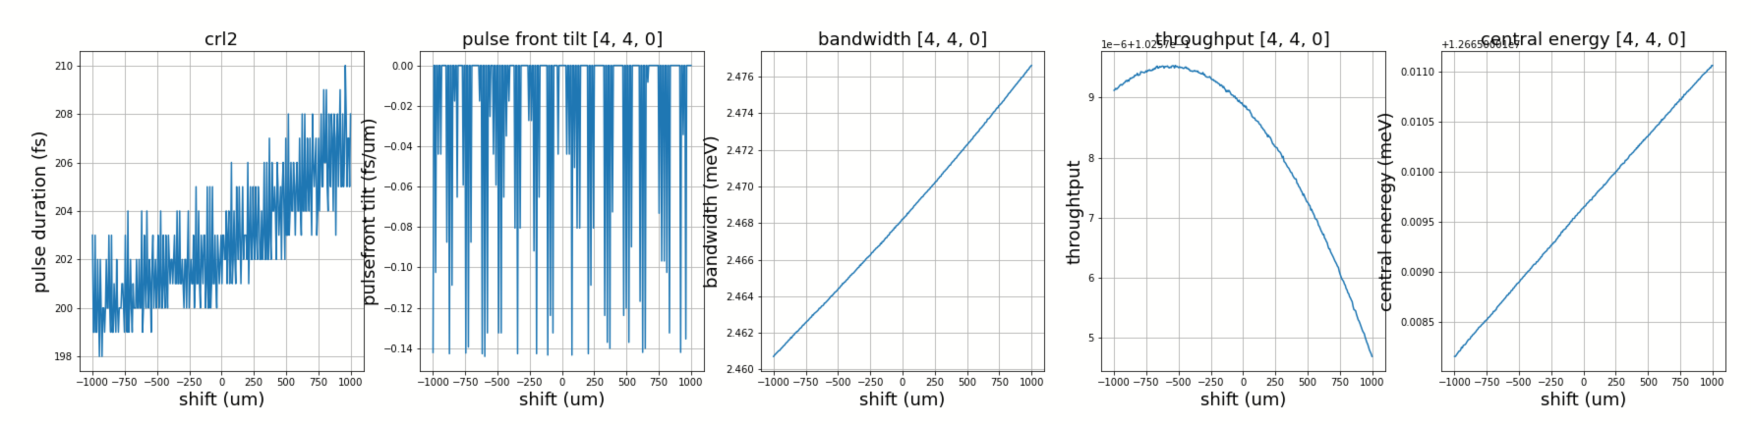
3). 12665 eV

Slide 26
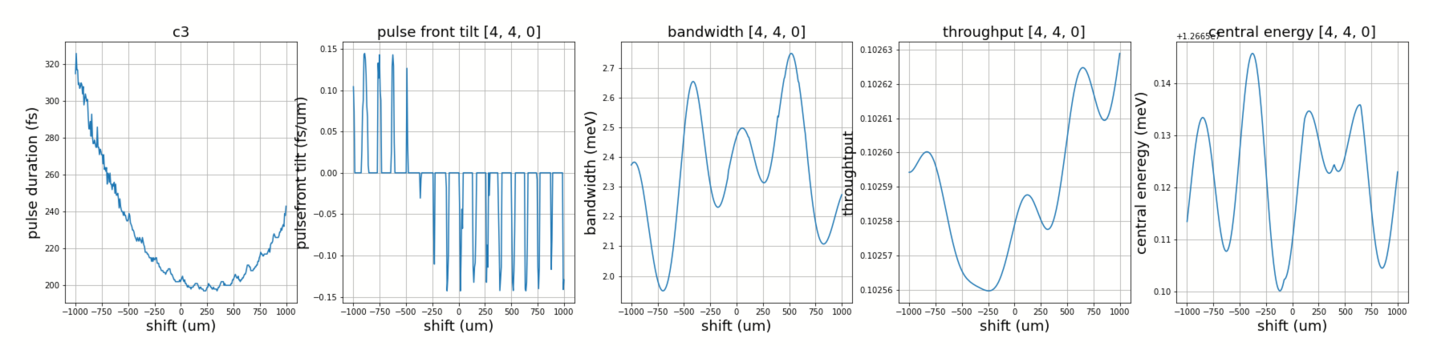
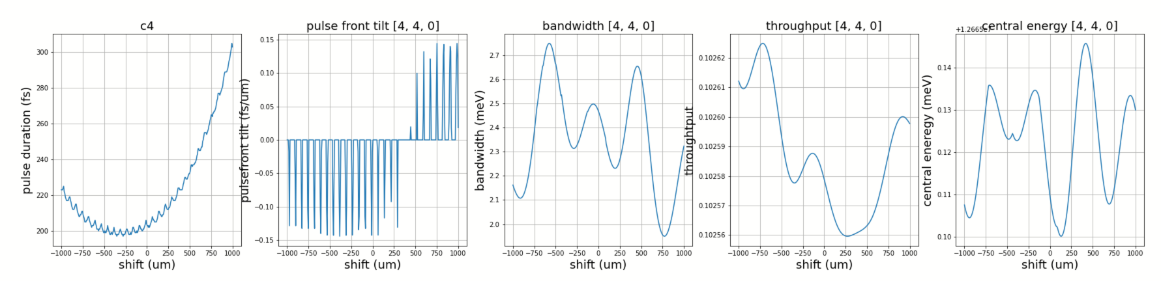
3). 12665 eV

Slide 27
4). 9481 eV

Slide 28
4). 9481 eV

Slide 29
4). 9481 eV

Slide 30
4. Collimation error tolerance
incident pulse duration: 100 fs
sampling time window: 10000 fs
slit width at focus: 100 um (pulse duration, pulse-front tilt)
7 um (bandwidth, throughput, central energy)

